Slide 1
Chapter 2
Reasoning and Proof

Slide 2
2-5 Objectives
_______________________________________________________________________________________________________________________________________________________________________________________
_____________________________________________________________

Slide 3
Properties of Equality
Addition Property
Subtraction Property
Multiplication Property
Division Property
Reflexive Property
Symmetric Property
Transitive Property
Substitution Property

Slide 4
Using Properties to Justify Steps when Solving Equations
What is the value of x? Justify each step.
Given:$\vec{AB}$bisects $RAN$

Slide 5
Properties of Congruence
Reflexive Property
Symmetric Property
Transitive Property

Slide 6
Using Properties of Equality and Congruence
What is the name of the property of equality or congruence that justifies going from the first statement to the second statement?
$2x+9=19$ $mE=mT$ $O  W$ and$W  L$
$2x=10$ $mT=mE$ $O  L$

Slide 7
Two-Column Proofs
A proof is a convincing argument that uses _____________________ (reasoning logically from given statements or facts)
Two column proofs list ______________________ on the left and ________________________ on the right.
The first statement is usually the ___________________________________.
Each statement must follow logically from ____________________________.
The last statement is what you _____________________________________.

Slide 8
Writing a Two-Column Proof
Given: $\overline{AB}≅\overline{CD}$
Prove: $\overline{AC}≅\overline{BD}$

Slide 9

Writing a Two-Column Proof
Given: $m1=m3$
Prove: $mAEC=mDEB$

Slide 10
Practice: p. 117 #5, 7, 8, 10, 12, 13, 23, 24 Challenge: pp. 118-119 #25-28

Slide 11
2-6 Objectives
_____________________________________________________________
_____________________________________________________________

Slide 12
Theorems about Angles
Vertical Angles Theorem
Congruent Supplements Theorem
Congruent Complements Theorem
Right Angles (Th. 2-4)
Congruent, Supplementary Angles (Th. 2-5)

Slide 13
Proving the Vertical Angles Theorem
Given: $1 and 3 are vertical angles$
Prove: $1=3$
2
1 3

Slide 14
Using the Vertical Angles Theorem
What is the value of x?

Slide 15
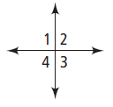
Proof Using the Vertical Angles Theorem
Given: $1  4$
Prove: $2  3$

Slide 16
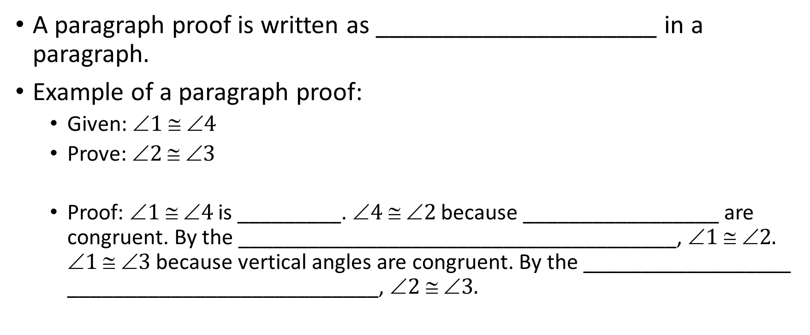
Paragraph Proofs
A paragraph proof is written as _____________________ in a paragraph.
Example of a paragraph proof:
Given: $1  4$
Prove: $2  3$
Proof: $1  4$is _________. $4  2$because _________________ are congruent. By the ______________________________________, $1  2.$ $1  3$because vertical angles are congruent. By the __________________ ___________________________, $2  3.$

Slide 17
Writing a Paragraph Proof
Given: $1 and 2$ are supplementary
$1 and 3$ are supplementary
Prove: $2  3$
3
1
2

Slide 18
Practice: pp. 125-126 #12, 17, 23, 30 Challenge: p. 127 #33-35

